Slide 1
PSR(4): ZAPP Edge Opt-in Propensity ZEDI: Model Re-train Updates
July 2026

Slide 2
Our Goal Develop a predictive model that identifies providers(both circle-backs and undecideds) most likely to opt in to ZAPP Edge payments, enabling proactive and targeted outreach.
INFORM | DISCUSS | DECIDE

Slide 3
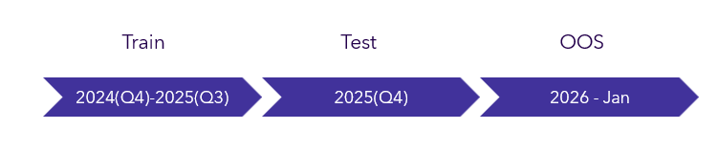
Model re-train included the following changes
Changes from Previous Model
INFORM | DISCUSS | DECIDE
Version 2.0
Additional data available
Data refresh (newer data)
Additional data elements
Update in model algorithm
Addition of top propensity drivers in output

Slide 4
The model aims to identify providers who are more likely to opt-in to ZAPP Edge
Model Dataset
INFORM | DISCUSS | DECIDE
Dataset | Time Period | Opt-in Percentage | Purpose
Training | 2024(Q4) to 2025(Q3) | 0.1% | Model development
Test | 2025(Q4) | 0.15% | Model tuning and performance evaluation on unseen providers
OOS | 2026-01-01 to 2026-02-01 | 0.08% | Evaluation on future performance

Slide 5
The features that have been used to build the model
Model Predictors
INFORM | DISCUSS | DECIDE
Predictor | Description
SUMCHECKPAYMENTAMOUNT90 | Payment amount in the past 90 days
CHECK_PAYMENTCOUNT_MOMENTUM_30_90 | A payment count momentum variable that looks at the ratio between average payment count in the past 30 days and average payment count in the past 90 days
TIME_SINCE_LAST_CHECK_PAYMENT | Time (days) since last check payment
PROVIDERTYPE_MEDICAL | Whether the provider type is medical or not
CHECK_PAYMENT_AVG_30 | The average payment (payment amount/count) in the past 30 days
PHONECOUNT60 | The number of disposition phone counts in the last 60 days of the observation period
PAYERID_CHECK_COUNT | The number of payers associated with all check payments since last opt-out
TOTAL_PREV_OPTOUTS_LAST_YEAR | Total number of previous opt-outs in the last year
TOTAL_PREV_OPTOUTS | Total number of previous opt-outs
TIME_SINCE_LAST_CANCELLED_CHECK_PAYMENT | Time (days) since last cancelled check payment
FIRSTACTION_BOOL | Whether the provider is an undecided (1) provider or a circle back provider (0). Can also be thought of as whether provider hasn’t had an opt-out
CANCELLEDCHECKPAYMENTCOUNT | The number of cancelled check payments

Slide 6
The output will include categorization for providers likely to opt-in
Model Output
INFORM | DISCUSS | DECIDE
Output
The model output will include:
ZAPP Edge opt-in propensity categorization
Outreach target recommendations
Call target recommendations
Very High opt-in propensity category
Not Petite (Low / Very Low)
Opt-In Category | Approx. Proportion of Data | Approx. Opt-In Rate Within Category | Total Pct of Opt-Ins Captured​ | Lift
Very High | ~2% | 0.82% | 11.52% | 10.36x
High | ~8% | 0.41% | 34.33% | 5.13x
Medium | ~17% | 0.17% | 40.94% | 2.23x
Low | ~17% | 0.06% | 11.40% | 0.77x
Very Low | ~56% | 0.002% | 1.80% | 0.03x
* OOS data approximations
On average, by looking at the top 2% of providers, the model can identify ~11% of providers that will opt-in with a ~0.82% target identification success rate

Slide 7
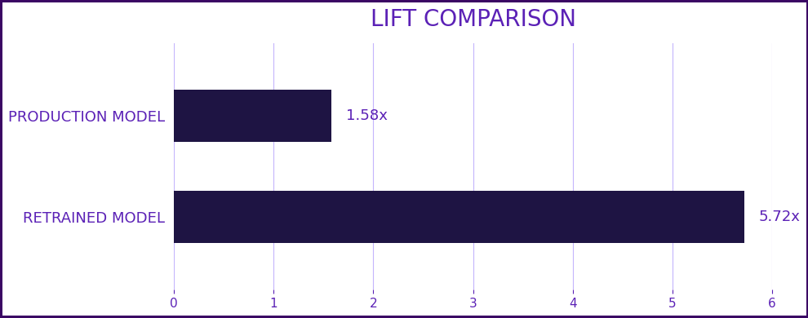
Retrained Model Delivers Higher Lift Across All Segments
Model Impact
INFORM | DISCUSS | DECIDE
Metric | Production Model | Retrained Model
Algorithm | Random Survival Forest | XGBClassifier
Overall Lift (OOS) | 1.58x | 5.72x
Circle Back Lift (OOS) | 1.92x | 3.75x
Undecided Lift (OOS) | 1.54x | 38.84x

Slide 8
The top opt-in drivers to empower PSR team in outreach efforts
Top Opt-in Drivers
INFORM | DISCUSS | DECIDE
Example Top Opt-in Drivers Deliverable
Provider | Opt-in Driver 1 | Opt-in Driver 1 Value | Opt-in Driver 2 | Opt-in Driver 2 Value | … | Opt-in Driver 5 | Opt-in Driver 5 Value
Provider-1 | PHONECOUNT60 | 9 | SUMCHECKPAYMENTCOUNT90 | 470 | … | PAYERID_CHECK_COUNT | 31
Provider-2 | PHONECOUNT60 | 6 | SUMCHECKPAYMENTCOUNT90 | 337 | … | PAYERID_CHECK_COUNT | 25
Provider-3 | TOTAL_PREV_OPTOUTS | 0 | PHONECOUNT60 | 1 | … | TIME_SINCE_LAST_CHECK_PAYMENT | 7

Slide 9


Slide 10


Slide 11
Model re-train included the following changes
Changes from Previous Model
Reassessment:
ZDS reevaluated the modeling approach as data assumptions evolved.
V1.0 Approach:
Survival analysis predicting event timing across multiple horizons (30, 60, 90 days).
Refined BU Need:
Identify providers likely to opt in to ACH.
V2.0 Approach:
Shift from survival analysis to a classification framework.

Slide 12
Data Filters
Filter Applied | Justification
Exclude EPC providers | Restricts the dataset to non-EPC providers, since EPC opt-in decisions follow different dynamics.
Only include Providers with at least one cheque payment | Excludes providers ineligible for ACH opt-in (those who don't receive paper checks).
Minimum 90- day observation window | Ensures every provider had sufficient time to make an opt-in decision.

Slide 13
The Best Performing ML Model
Model Output
XGBoost achieves strong, consistent ranking quality across all splits (ROC-AUC 0.87–0.92), with 92–96% of opt-ins captured in the top 3 deciles — confirming the model is both accurate and generalizable.
Model Name | Dataset | AUC | Accuracy | Precision | Recall | F1 | Decile-1 Capture % | Decile-2 Capture % | Decile-3 Capture % | Top 3 Deciles Capture %
XGBClassifier | Train | 0.8957 | 0.6814 | 0.003 | 0.9498 | 0.006 | 61.3281 | 22.1635 | 10.4071 | 93.8988
XGBClassifier | Validation | 0.9229 | 0.6808 | 0.0047 | 0.9741 | 0.0093 | 71.5520 | 17.2482 | 7.4775 | 96.2778
XGBClassifier | OOS | 0.8726 | 0.6701 | 0.0023 | 0.9316 | 0.0046 | 45.9783 | 29.0516 | 16.5666 | 91.5966

Slide 14
Random Survival Forest Decile Analysis – OOS Testing
Baseline Model Output
Decile | Counts | Positive Target | Target Rate | Overall_Target PCT | Lift
1 | 35810 | 1248 | 3.4851 | 15.9468 | 1.5890
2 | 35881 | 994 | 2.7703 | 12.7013 | 1.2631
3 | 35569 | 884 | 2.4853 | 11.2957 | 1.1332
4 | 35814 | 870 | 2.4292 | 11.1168 | 1.1076
5 | 35839 | 874 | 2.4387 | 11.1679 | 1.1119
6 | 35399 | 814 | 2.2995 | 10.4012 | 1.0485
7 | 36302 | 570 | 1.5702 | 7.2834 | 0.7159
8 | 35238 | 361 | 1.0245 | 4.6128 | 0.4671
9 | 35460 | 602 | 1.6977 | 7.6923 | 0.7741
10 | 35521 | 609 | 1.7145 | 7.7818 | 0.7817

Slide 15
XGBoost Decile Analysis – OOS Testing
Model Output
XGBClassifier achieves strong, consistent ranking quality with 91% of opt-ins captured in the top 3 deciles.
Decile | Counts | Positive Target | Target Rate | Overall_Target PCT | Lift
1 | 84241 | 383 | 0.454648 | 45.97839 | 5.538954984
2 | 105068 | 242 | 0.230327 | 29.05162 | 2.806063378
3 | 118163 | 138 | 0.116788 | 16.56663 | 1.422820628
4 | 97768 | 51 | 0.052164 | 6.122449 | 0.635515314
5 | 58084 | 5 | 0.008608 | 0.60024 | 0.104873573
6 | 80004 | 3 | 0.00375 | 0.360144 | 0.04568379
7 | 112175 | 4 | 0.003566 | 0.480192 | 0.043442668
8 | 118195 | 2 | 0.001692 | 0.240096 | 0.020615006
9 | 104884 | 5 | 0.004767 | 0.60024 | 0.058078225
10 | 136258 | 0 | 0 | 0 | 0

Slide 16
XGBoost Decile Analysis – OOS Testing
Model Output for Circlebacks
Decile | Counts | Positive Target | Target Rate | Overall_Target PCT | Lift
1 | 78234 | 327 | 0.417976839 | 44.18918919 | 3.617482
2 | 99363 | 224 | 0.225436027 | 30.27027027 | 1.951091
3 | 111722 | 129 | 0.115465172 | 17.43243243 | 0.999321
4 | 90812 | 49 | 0.053957627 | 6.621621622 | 0.466989
5 | 25757 | 4 | 0.015529759 | 0.540540541 | 0.134406
6 | 20034 | 1 | 0.004991514 | 0.135135135 | 0.0432
7 | 30871 | 1 | 0.003239286 | 0.135135135 | 0.028035
8 | 51029 | 1 | 0.00195967 | 0.135135135 | 0.01696
9 | 61545 | 4 | 0.006499309 | 0.540540541 | 0.05625
10 | 71084 | 0 | 0 | 0 | 0

Slide 17
XGBoost Decile Analysis – OOS Testing
Model Output for Undecideds
Decile | Counts | Positive Target | Target Rate | Overall_Target PCT | Lift
1 | 6007 | 56 | 0.9322 | 60.2150 | 37.5293
2 | 5705 | 18 | 0.3155 | 19.3548 | 12.7015
3 | 6441 | 9 | 0.1397 | 9.6774 | 5.6250
4 | 6956 | 2 | 0.0287 | 2.1505 | 1.1574
5 | 32327 | 1 | 0.0030 | 1.0752 | 0.1245
6 | 59970 | 2 | 0.0033 | 2.1505 | 0.1342
7 | 81304 | 3 | 0.0036 | 3.2258 | 0.1485
8 | 67166 | 1 | 0.0014 | 1.0752 | 0.0599
9 | 43339 | 1 | 0.0023 | 1.0752 | 0.0928
10 | 65174 | 0 | 0 | 0 | 0

